Slide 1
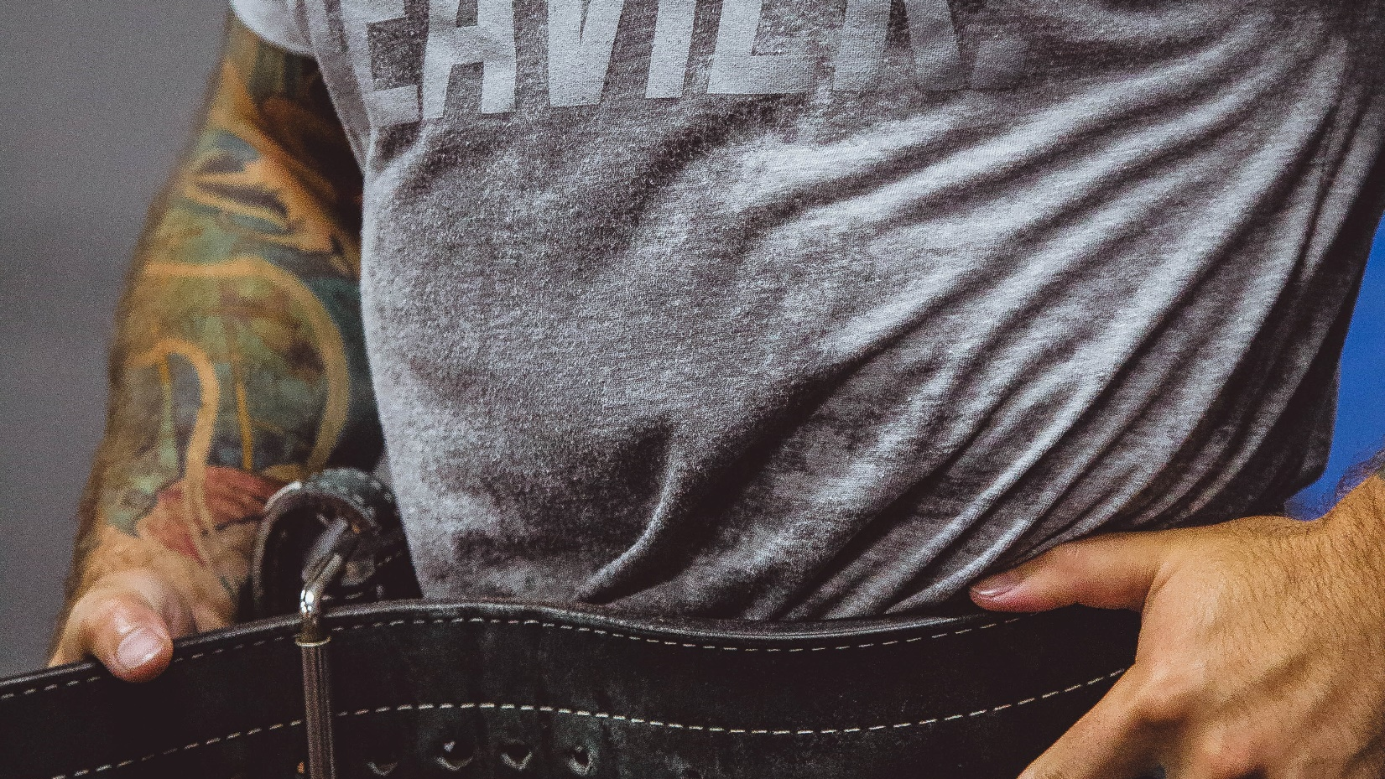
POWERLIFTING DATA ANALYSIS 2020

Slide 2
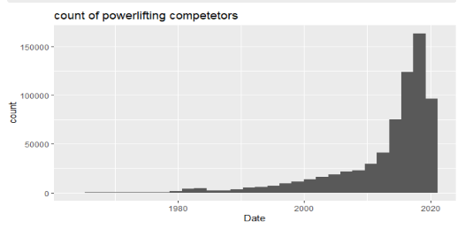
Background
Powerlifting is a sport that has exploded in recent years as the following histogram shows
The database was acquired through Openpowerlifting.org and it had data about Powerlifting competitors from 1964 up to September 2020

Slide 3
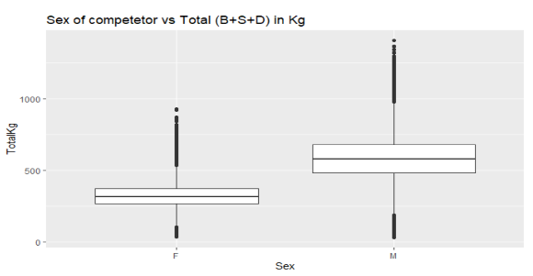
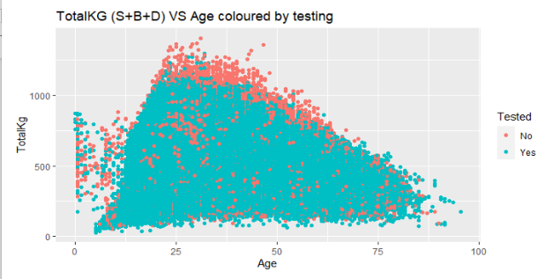
Introduction
Explaratory analysis was first conducted and it seemed like sex had big influence on total weight lifted
The heaviest lifts also seemed to happend around 20-30 years of age

Slide 4
Cleaning/Tidying
In the analysis, data in 2020 only was used
Grouped weight classes to form 3 specific weight classes based on IPF sepcifications

Slide 5
Methodology: 1) Used Lasso model to compare importance of each variable 20k observations 2) Used pam clustering to see if data would naturally cluster itself into weight-classes

Slide 6
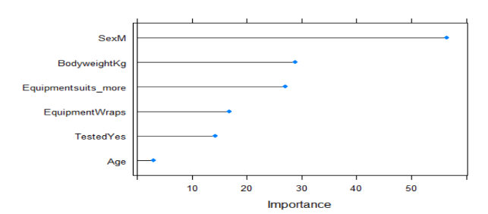
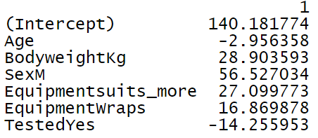
Results Squats

Slide 7
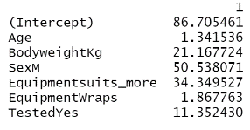
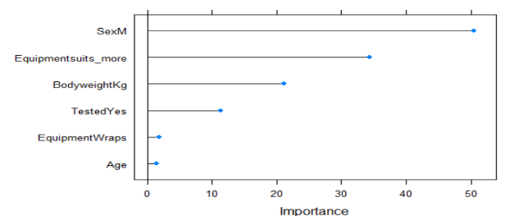
Bench Press

Slide 8
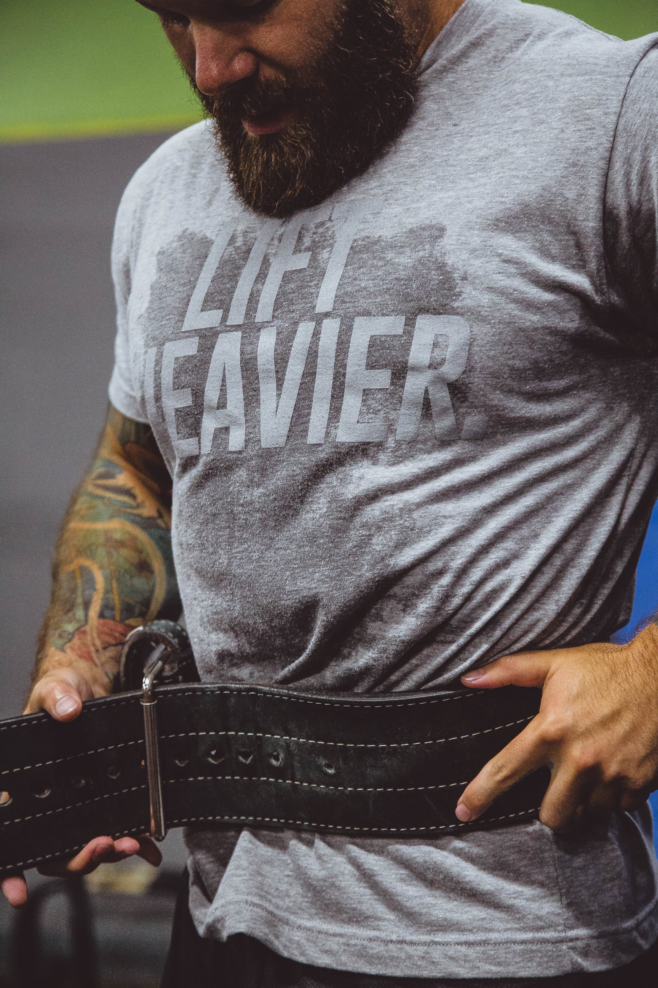
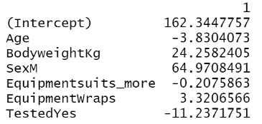
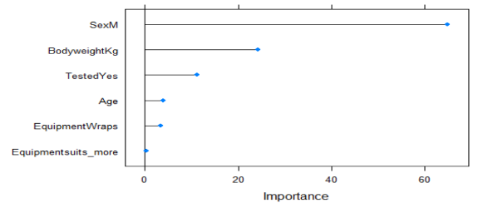
Deadlift

Slide 9
Clustering and weight classes:
Male cluster frequency (table 1)
Male cluster frequency (table 1) | Lightweight | Midweight | Heavyweight
1st Cluster | 397 | 1501 | 1433
2nd cluster | 1991 | 2566 | 890
3rd cluster | 2962 | 1075 | 251

Slide 10
Female cluster frequency (table 2)
Female cluster frequency (table 2) | Lightweight | Midweight | Heavyweight
1st Cluster | 358 | 479 | 810
2nd cluster | 1396 | 501 | 381
3rd cluster | 1034 | 843 | 779

Slide 11
Asuumptions/limitations
It is important to note that powerlifting meet labeled as not tested does not mean that all competitors are on drugs and a meet labeled as tested does not guarantee that all the participants are tested.
The analysis was done on the meets done this year, and due to Covid situation that makes this year a unique case, we should be careful when trying to extrapolate results from this analysis to data about meets in previous years.

Slide 12
Discussion
Variables importance comparison: results seem to indicate that being a male is the more important than all of the other factors considered in lifting more weight. We can just speculate that this might be a result of the hormonal composition that males seem to have, but this just a speculation. More research is needed in this area, to give us a clear picture of why sex might be this important in influencing the ability to lift heavier loads.
Clustering and weight classes: did not find very significant trends in the male or female clusters to show that weight classes would “naturally” take place. This might seem as a result that undermines the concept of weight classes; however, the results from a method like clustering using only 9 variables used on a dataset of modest size ( around 13k rows for men and 7k for women) are not conclusive by any means. More research is needed to give us a clearer picture about the importance or lack of weight classes in powerlifting.

